Slide 1

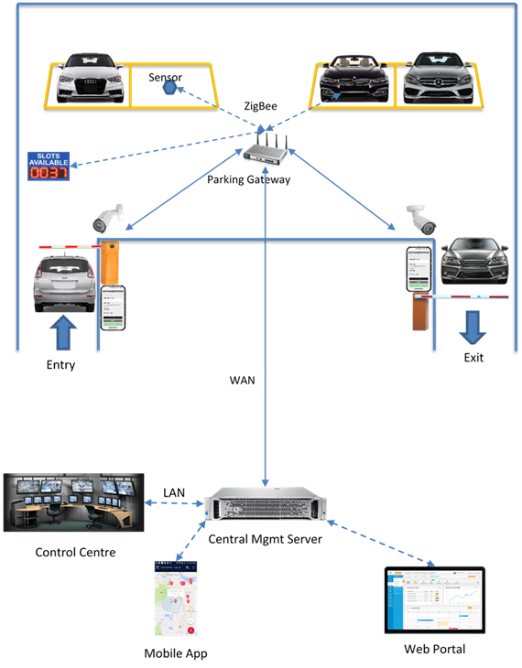
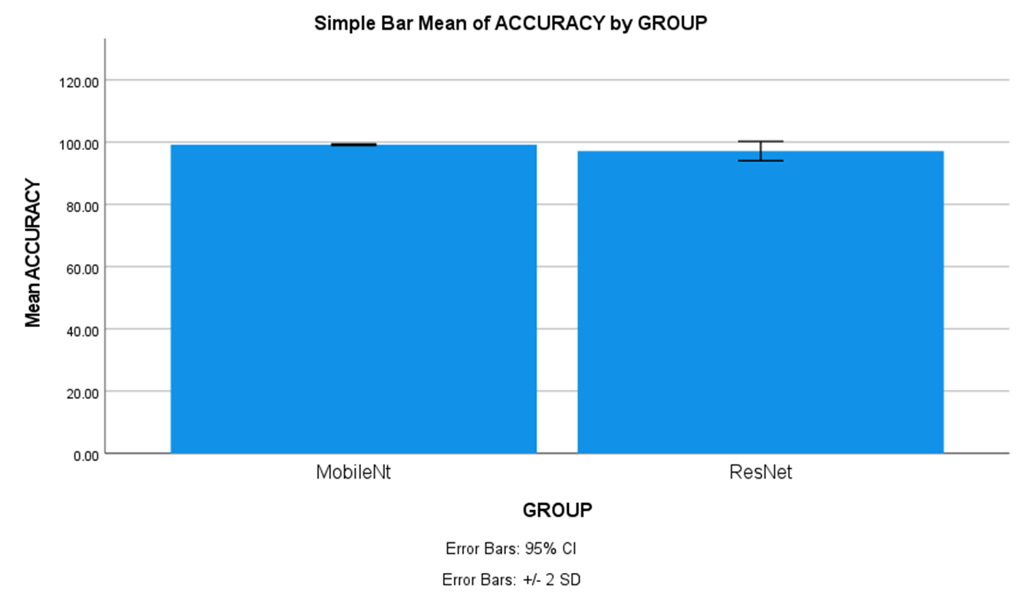
Name: N.S Lakshmi Charith Register Number: 192111138
Guided by Dr. S.Sankar
Ms. Poorani.S
Guided by Dr. Mary Valantina. G
Efficient Smart Parking System Using ResNet Algorithm Comparing with MobileNet-V2 Algorithm
INTRODUCTION
In urban areas, vehicles are predominantly used for transportation, leading to increasing congestion and a diminishing availability of parking spaces. An efficient smart parking system can significantly alleviate these issues by optimizing parking space usage, reducing traffic and decreasing carbon emissions.
The aim of this study is to classify real-time processing and decision-making, ensuring quick and accurate identification of available parking spaces by using two deep learning algorithms.
In this research study, MobileNetV-2 algorithm is compared with ResNet algorithm to enhance accuracy. MobileNet-V2 has a more straightforward architecture with stacked convolutional layers, better suited for capturing the visual features of the parking spots. ResNet will handle complex visual data like image classification and object detection makes it a versatile tool for computer vision applications.
The research will employ a diverse dataset of car parking images encompassing various spaces to evaluate the effectiveness of car parking identification algorithms.
The advantage of MobileNet-V2 algorithm is having higher accuracy when compared with ResNet algorithm.
MATERIALS AND METHODS
The Research work is carried out MobileNet-V2 Algorithm is in Group 1 and Group 2 is compared of ResNet algorithm. The sample size is given to each group 10 times.
Alpha, Beta, G-Power, CI and threshold values for the study are 0.05, 0.2, 0.8 and 95% respectively.
The Dataset is Made up of Images, there were 5000 images in this particular dataset. The dataset includes details of occupied and un occupied parking spaces and different size of vehicles.
A testing setup called both hardware and software configurations with windows compatibility.
SPSS tool is used for calculating t-test values. Independent and dependent variables were considered.
System Initialization
Acquiring Reference Image
Image Enhancement
Identifying Parking Space
Checks Availability
Acquiring Image (with Cars)
Coordinates Parking Area
Display Output
RESULTS
The MobileNet-V2 algorithm accuracy is 97% and accuracy for ResNet algorithm is 96.42%.
The Mean accuracy of the MobileNet-V2 algorithm is 97%, with a standard deviation of 0.58%. For ResNet, the mean accuracy and standard deviation are 96.42 and 0.45 respectively.
Group |  | N | Mean | Standard Deviation | Standard Error Mean
Accuracy rate | MobileNetv | 10 | 97.4500 | .30277 | .09574
 | Resnet | 10 | 96.4500 | .72541 | .22940
DISCUSSION AND CONCLUSION
Based on obtained results, MobileNet-V2 has significantly better accuracy (97%) compared to ResNet Algorithm accuracy (96.42).
The Independent samples T-test revealed a statistically significant difference value of (p=0.013) (independent sample T - test p<0.05) is obtained and shows that there is a statistical significant difference between the group 1 and group 2.
In this study, the main contributors are vehicles and parking spaces. The MobileNet-V2 algorithm demonstrates an accuracy rate of 97%, outperforming ResNet, which achieves 96% accuracy. This findings revealed that MobileNet-V2 achieved higher accuracy in classifying images compared to ResNet algorithm.
This research has identified that smart parking is evolving from simply finding an empty spot to navigate cities, and managing our resources with efficiency and sustainability with advancements in automation and vehicle integration.
From the work , it is concluded that the MobileNet-V2 algorithm attains high accuracy. MobileNet-V2’s ability to run efficiently on devices with good accuracy makes it a strong foundation for future advancements in embedded applications, medical diagnosis and wearable tech.
BIBLIOGRAPHY
Grbić, Ratko, and Brando Koch. 2023. “Automatic Vision-Based Parking Slot Detection and Occupancy Classification.” Expert Systems with Applications 225 (120147): 120147.
Hayawi, D. Mustafad Mustafa J. Hayawi J., and Satar Shaker Muhammad. 2022. “Detection Parking Spaces by Using the ResNet50 Algorithm.” Journal of Al-Qadisiyah for Computer Science and Mathematics 14 (2). https://doi.org/10.29304/jqcm.2022.14.2.932.
Neupane, Dhiraj, Aashish Bhattarai, Sunil Aryal, Mohamed Reda Bouadjenek, Ukmin Seok, and Jongwon Seok. 2024. “Shine: A Deep Learning-Based Accessible Parking Management System.” Expert Systems with Applications 238 (122205): 122205.
Iqbal, Md Ifraham, Mazharul Islam Leon, Nilambar Haldar Tonmoy, Jahidul Islam, and Amit Ghosh. 2021. “Deep Learning Based Smart Parking for a Metropolitan Area.” In 2021 IEEE Region 10 Symposium (TENSYMP). IEEE. https://doi.org/10.1109/tensymp52854.2021.9550904.
Zhuang, Yifan, Ziyuan Pu, Hao Yang, and Yinhai Wang. 2022. “Edge–artificial Intelligence-Powered Parking Surveillance with Quantized Neural Networks.” IEEE Intelligent Transportation Systems Magazine 14 (6): 107–21.

